Slide 1
Cognitive Assistive Technology
Amanda M. Reinsfelder, ATP
Assistive Technology Specialist

Slide 2
The views expressed in this presentation are those of the author and do not reflect the official policy of the Department of the Army, Department of Defense, or U. S. Government.

Slide 3
AT Takes a Team Effort!
Patient and family
Assistive Technology Provider (ATP)
Occupational Therapy
Speech Language Pathology
Audiology
Physical Therapy
Psychology/Neuropsychology
Case Managers
Social Work
Vocational Rehabilitation Counseling
Recreation Therapy
Physiatry
Nursing
And more……

Slide 4
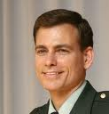
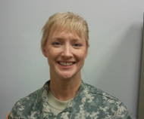
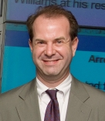
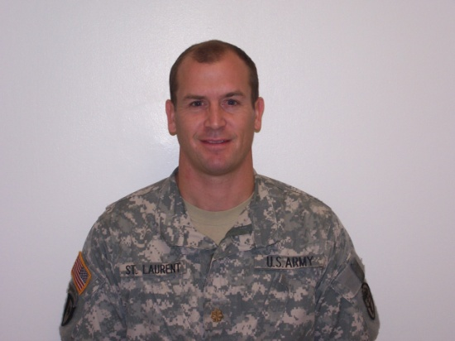

And leadership!

Slide 5
Team Effort:
Collaboration with Other Disciplines
Reporting findings to other team members
  “During my session, I observed….”
Receiving feedback from team members
  “A flashing alarm clock will not be appropriate in this situation because…”
  “Make sure the vocabulary choices include….”
Notes:
This is especially important for patients with sensitive issues.
I am not a therapist, physician, or behavioral health provider – nor do I want to try to pretend to be one.
We work together, and I can be an extra set of “eyes and ears” for the other disciplines.
If there are any questions, the appropriate discipline can be approached for their expert opinion – minimizing any risks of Assistive Technology abandonment, and increasing the chances of a successful solution.
Example for bullet 1: The patients hands were shaking during the session, and he seemed easily distracted.
Example for bullet 2: - flashing lights may trigger flashbacks, or cause seizures.
- Vocabulary for a patient using AAC, who might be an inpatient. The Speech Language Pathologist may know appropriate key phrases specific for that particular person.

Slide 6

The Research
Individuals with Traumatic Brain Injury were found to have more troubles with:
  Headaches
  Dizziness
  Vision
  Attention
  Information Processing
  Executive Functioning (Prospective Memory and Planning)
  Memory / Learning Problems
Notes:
Image taken from Microsoft clipart.
1. Kraus JK, Schaffer K, Ayers K, Stenehjem J, Shen H, Afifi AA. (2005). Physical Complaines, Medical Service Use, and Social and Employment Changes Following Mild Traumatic Brain Injury: A 6 Month Longitudinal Study. J Heaed Trauma Rehabilitation. 20 (3). 239-256.
2. Fish J, Manly T, Emslie H, Evans JJ, Wilson BA. (2008). Compensatory Strategies for Acquired Disorders of Memory and Planning: Differential Effects of a Paging System for Patients with Brain Injury of Traumatic Versus Cerebrovascular Aetiology. J Neurol Neurosurg Psychiatry. 79. 930-935.
3. Culley C, Evans JJ. (2010). SMS Text Messaging as a Means of Increasing Recall of Therapy Goals in Brain Injury Rehabilitation: A Single-Blind Within-Subjects Trail. Neuropsychological Rehabilitation, 20(1). 103-119.
4. Scherer MJ. (2005). Assessing the Benefits of Using Assistive Technologies and Other Supports for Thinking, Remembering, and Learning. Disability and Rehabilitation. 27(13).731-739.
5. (Executive Functioning to include: planning, task sequencing and prioritization, task switching, self monitoring, problem solving, and self initiation/ adaptability; Information processing: visual spatial processing, auditory processing, sensory motor processing, language processing, understanding of social cues.)
Lopresti EF, Milhailidis A, Kirsch N. (2004). Assistive Technology for Cognitive Rehabilitation: State of the Art. Neuropsychological Rehabilitation, 14(1/2), 5-39.

Slide 7
Familiar Solutions
It may be easier for someone to implement a strategy / tool that is already familiar
What are they currently using?
How can we make what they already have work for them?
Notes:
Culley C, Evans JJ. (2010). SMS Text Messaging as a Means of Increasing Recall of Therapy Goals in Brain Injury Rehabilitation: A Single-Blind Within-Subjects Trail. Neuropsychological Rehabilitation, 20(1). 103-119.
Hoogerdijk B, Runge U, Haugboelle J. (2011). The Adaptation Process After Traumatic Brain Injury: An Individual and Ongoing Occupational Struggle to Gain a New Identity. Scandinavian Journal of Occupational Therapy. 18. 122-132.
Lund ML, Lovgren-Engstrom AL, Lexell J. (2011) Using Everyday Technology to Compensate for Difficulties in Task Performance in Daily Life: Experiences in Persons with Acquired Brain Injury and Their Significant Others. Disability and Rehabilitation: Assistive Technology. 6(5). 402-411.

Slide 8
Introducing “New” Solutions
If currently owned tools are not sufficient, feature matching is done to select a new tool.
Individual needs are more important than availability, simplicity, or popularity
Notes:
Take home message: What works for one, won’t be the best solution for all cases.
Lund ML, Lovgren-Engstrom AL, Lexell J. (2011) Using Everyday Technology to Compensate for Difficulties in Task Performance in Daily Life: Experiences in Persons with Acquired Brain Injury and Their Significant Others. Disability and Rehabilitation: Assistive Technology. 6(5). 402-411.
Scherer MJ. (2005). Assessing the Benefits of Using Assistive Technologies and Other Supports for Thinking, Remembering, and Learning. Disability and Rehabilitation. 27(13).731-739.

Slide 9
Things to Consider…
Physical, sensory and cognitive abilities
Expectation of technology
Reaction to technology
Previous experiences with technology
Personality
Financial and social support for future use
Notes:
Scherer MJ. (2005). Assessing the Benefits of Using Assistive Technologies and Other Supports for Thinking, Remembering, and Learning. Disability and Rehabilitation. 27(13).731-739.
Lopresti EF, Milhailidis A, Kirsch N. (2004). Assistive Technology for Cognitive Rehabilitation: State of the Art. Neuropsychological Rehabilitation, 14(1/2), 5-39.
Vision, hearing, tactile sense, fine motor control, ability to speak, coordination / ability to select small buttons

Slide 10
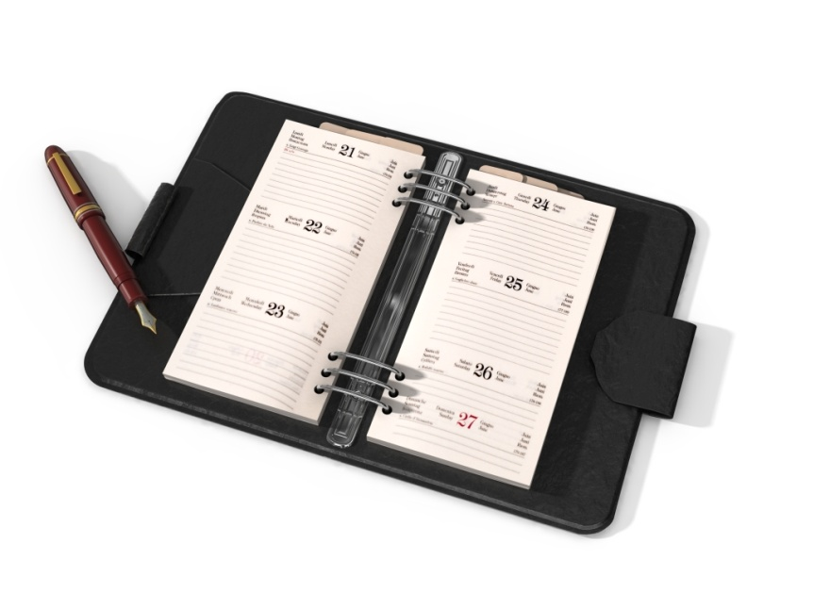
Reminder:
Definition of Assistive Technology
“…any item, piece of equipment, or product system, whether acquired commercially, modified, or customized, that is used to increase, maintain, or improve functional capabilities of individuals with disabilities.” (Assistive Technology Act of 1998; reauthorized in 2004)

Slide 11
Every Day Technology vs.
Assistive Technology
How is it used?
What is the purpose/goal?
Does it help meet a need?
Benefit: “If it doesn’t make me look ‘different’, I will be more likely to use it.”
Notes:
Lund ML, Lovgren-Engstrom AL, Lexell J. (2011) Using Everyday Technology to Compensate for Difficulties in Task Performance in Daily Life: Experiences in Persons with Acquired Brain Injury and Their Significant Others. Disability and Rehabilitation: Assistive Technology. 6(5). 402-411.

Slide 12
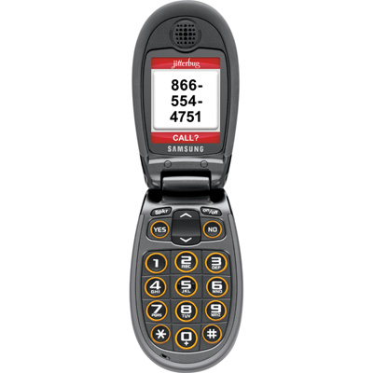
Let’s take a vote!
Who does not have a cell phone?
Who has a cell phone? (Hold it up!)
Keep it up if it is a smart phone.
Keep it up if you use it for reminders.
Keep it up if you use it for pictures.
What else do you use it for?
Notes:
Pictures can also be a memory tool

Slide 13
The Point:
What is readily available?
What are current resources?
Can current tool be adjusted to meet the needs?
Phones are great for some, but not the end-all solution for everyone
Notes:
Not everyone here has a cell phone or a smart phone.
Lund ML, Lovgren-Engstrom AL, Lexell J. (2011) Using Everyday Technology to Compensate for Difficulties in Task Performance in Daily Life: Experiences in Persons with Acquired Brain Injury and Their Significant Others. Disability and Rehabilitation: Assistive Technology. 6(5). 402-411.
Scherer MJ. (2005). Assessing the Benefits of Using Assistive Technologies and Other Supports for Thinking, Remembering, and Learning. Disability and Rehabilitation. 27(13).731-739.

Slide 14
My phone can do what?!?
Most people don’t realize all of the features already in their pockets
Customized alarms and alerts
Synced to cloud systems for backup
Share with family members or other parties
Many free applications provide small features that make a big impact
Notes:
The “cool factor” and motivation to be compliant

Slide 15
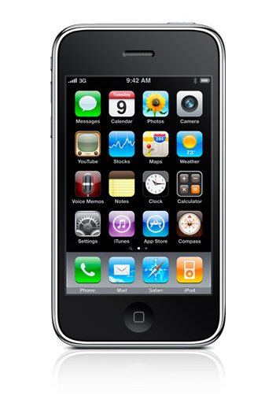
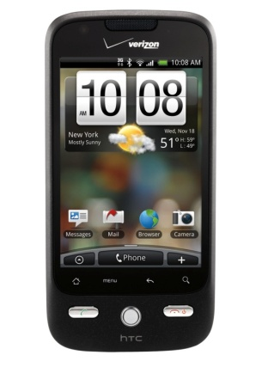
Which Operating System?
What does the person currently use?
Educate where both can be compatible with each other
  (My phone is an one operating system, but my Tablet is another. Do I need a new phone?)
Other platforms also exist
Use what is the most natural for the person

Slide 16
What if my phone isn’t “smart”…?
Most basic phone features include:
  Calendar stored on phone’s memory
  Ability to send and receive text messages
  Ability to connect to Bluetooth
Always consider the person’s cell phone plan!

Slide 17

Online Reminder Systems

Slide 18
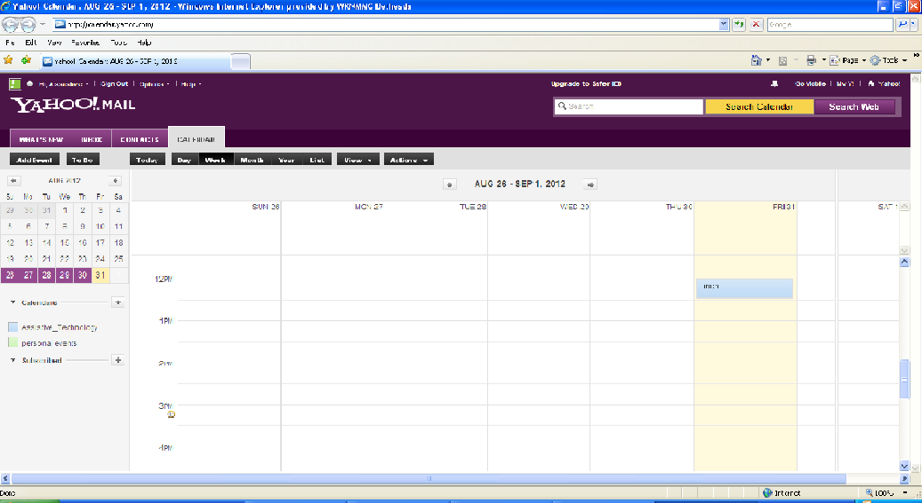
Yahoo!

Slide 19
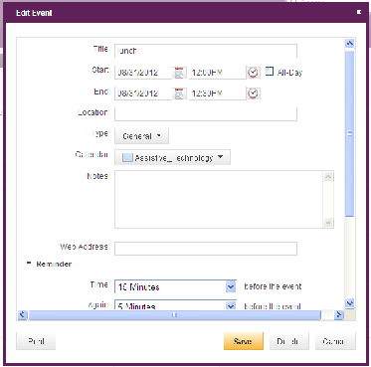
Yahoo!

Slide 20
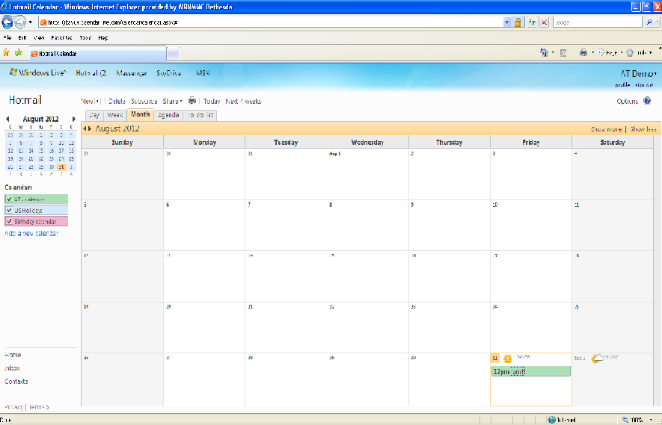
Hotmail

Slide 21
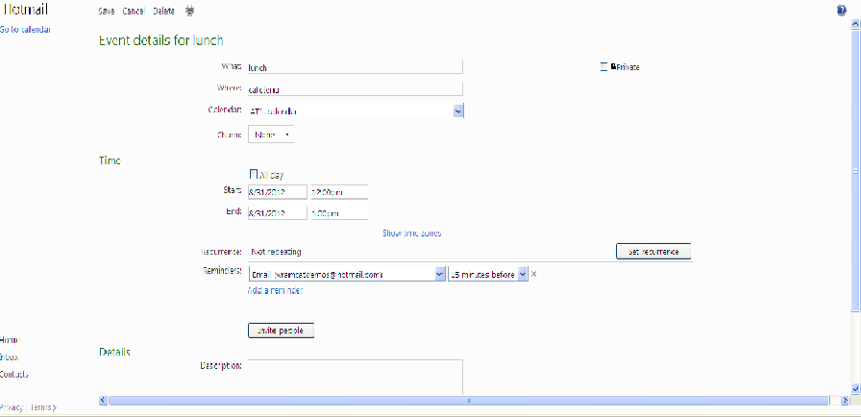
Hotmail

Slide 22
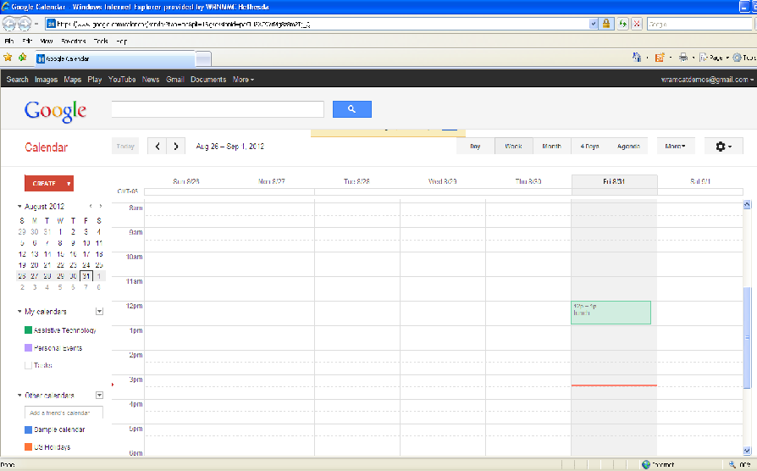
Gmail

Slide 23
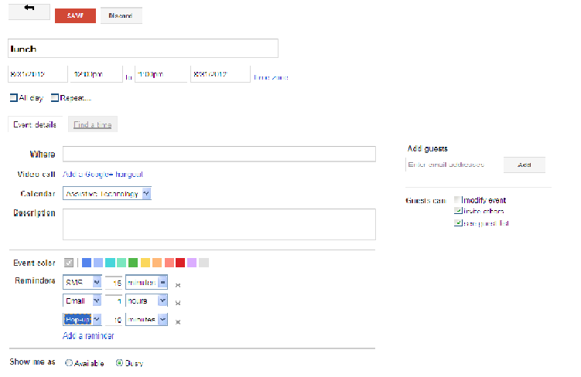
Gmail

Slide 24
Password Recovery
Passwords are required for cloud based systems
Remembering them can be an issue
Comfort levels may vary with strategies to remember passwords
Refer to Occupational Therapist or other provider for cognitive strategies
Notes:
Password keeper applications, memo pad

Slide 25
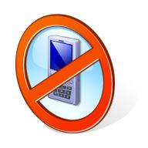
“That’s not for me.”
I only want to make calls on my phone.
I don’t want to be reachable at all times.
I am afraid I will lose my phone.
It is difficult to physically reach for my phone.
My phone is too small.
I like paper better.
Notes:
Only want to make calls on my phone
Don’t want to be reachable at all times
- iTouch or
Afraid I will lose my phone
ZOMM
Difficult to physically reach for my phone
Smart Watch
My phone is too small.
Tablet organizer
I like paper better.
use a physical notebook with pen and paper.

Slide 26
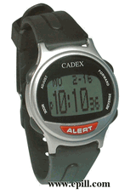
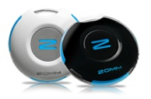
That’s ok!
Wireless Leash
Small portable touch screen device
Smart watch
Tablet Organizer
Traditional pen and paper
“Not-smart” watches

Slide 27
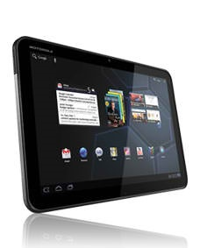
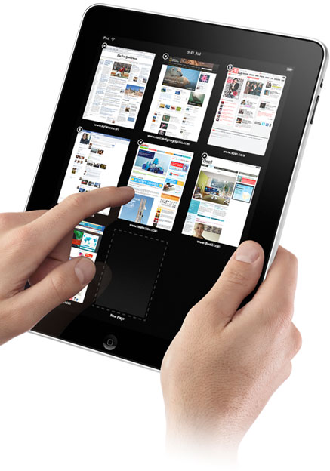
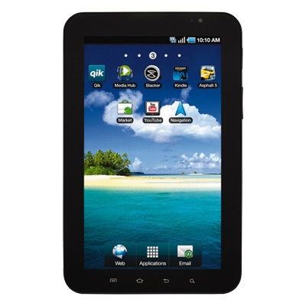
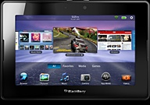
Isn’t it all the same?

Slide 28
K.I.S.S. = Keep It Simple, Silly!
What is the GOAL?
Is the tool able to help them accomplish the goal?
“Glitz and Glamour” are not always necessary nor appropriate to accomplish the task successfully!
Notes:
It does not need to be flashy.

Slide 29
Other Assistive Technology for Thought Organization and Information Processing

Slide 30
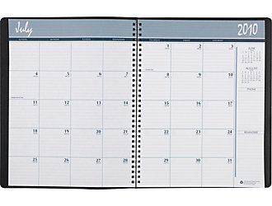
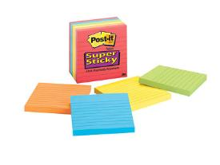
Time Management / Organization
Low Tech
  Sticky notes
  Pre-organized books/folders
  Data planners
  Alarms / timers
  Highlighters
  Highlighter tape
Notes:
Scherer MJ. (2005). Assessing the Benefits of Using Assistive Technologies and Other Supports for Thinking, Remembering, and Learning. Disability and Rehabilitation. 27(13).731-739.

Slide 31
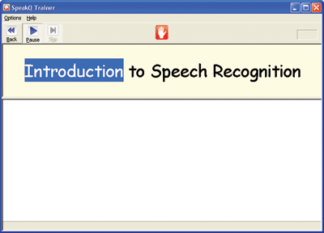
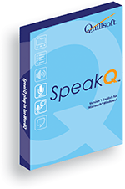
Thought Organization
Dragon Naturally Speaking©
Windows Speech Recognition©
  (only available in Windows 7© and more recent versions)
WordQ© / SpeakQ©
Word Prediction

Slide 32

Thought Organization
Claro Read©
DraftBuilder©
Inspiration©
Read and Write Gold©
Kurzweil 3000©
WYNN©
Mindview©
Notes:
Multitasking might be difficult
myscript

Slide 33

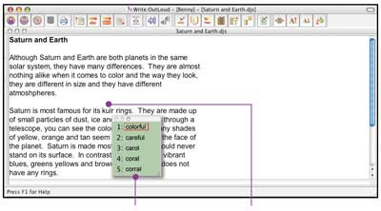
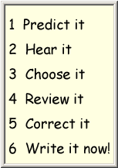
Thought Organization
Co:Writer 4000©
WordQ©
Notes:
Co:Writer and WordQ are examples of word prediction programs. These programs help individuals who may have a hard time spelling. Some programs allow the individual to have the program read it back to him/her to hear if he/she has made any mistakes. This helps some people who have a hard time writing sentences by giving suggestions for words they may not remember how to spell.

Slide 34
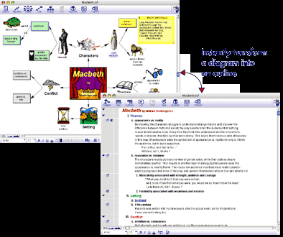
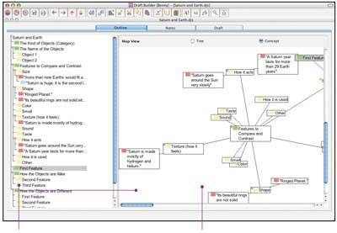
Concept Mapping Examples
Draft:Builder©
Inspiration©
Notes:
Lopresti EF, Milhailidis A, Kirsch N. (2004). Assistive Technology for Cognitive Rehabilitation: State of the Art. Neuropsychological Rehabilitation, 14(1/2), 5-39.
It is very difficult for some individuals to write with only words. It is helpful to write using pictures and visually mapping out ideas. Inspiration helps writers convert these pictures to outlines.
Draft:Builder is another program that assists in report writing. It turns diagrams into outlines and assists the individual in sorting out thoughts to put the report in a logical order.

Slide 35
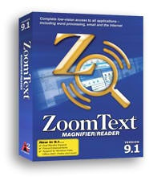
Information Processing / Comprehension
Text to Speech
Some magnification software programs also highlight as they read
Notes:
Myscript
Reference Lopresti EF, Milhailidis A, Kirsch N. (2004). Assistive Technology for Cognitive Rehabilitation: State of the Art. Neuropsychological Rehabilitation, 14(1/2), 5-39.
Which talks about how computers can have provide information in multiple methods.

Slide 36
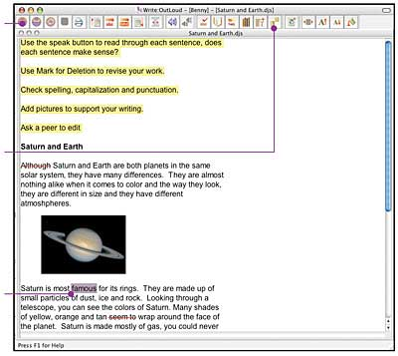
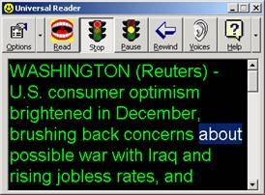
Text To Speech Software
Universal Reader©
Write:OutLoud©
Notes:
It helps some individuals to comprehend documents if they are able to hear the text. These programs highlight the text as it is being read to help the reader follow what is being said.
Reference Lopresti EF, Milhailidis A, Kirsch N. (2004). Assistive Technology for Cognitive Rehabilitation: State of the Art. Neuropsychological Rehabilitation, 14(1/2), 5-39.
Which talks about how computers can have provide information in multiple methods.

Slide 37
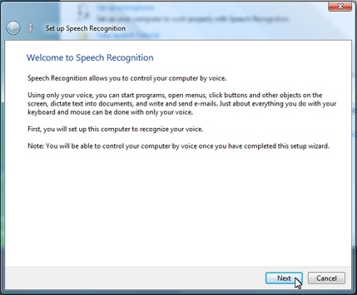


Speech Recognition Software
(Speech to Text)
Windows Speech Recognition©
Notes:
Dragon Naturally Speaking allows the computer user to operate documents and programs solely by voice. However, it is always a good idea to have a second method for accessing the computer available (mouse, switches, etc.).
Good for people who may have dyslexia or other speech issues.
Reference Lopresti EF, Milhailidis A, Kirsch N. (2004). Assistive Technology for Cognitive Rehabilitation: State of the Art. Neuropsychological Rehabilitation, 14(1/2), 5-39.
Which talks about how computers can have provide information in multiple methods.

Slide 38
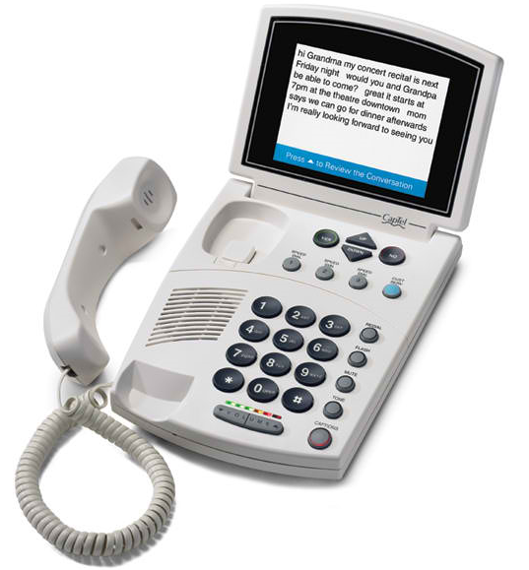
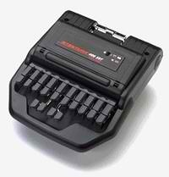
Speech to Text
Examples:
Real Time Captioning
Photo from: http://webaim.org/techniques/captions/realtime
Captioned Telephone© www.captel.com
Notes:
Assists with information processing

Slide 39
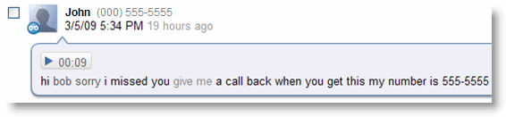
Speech to Text
Example:
Google© Voicemail Transcription
Video:
http://www.youtube.com/watch?v=fHuai7-jVlY&feature=player_embedded
Photo taken from: http://www.google.com/support/voice/bin/answer.py?answer=115986
Notes:
Play saved copy if link is not available

Slide 40
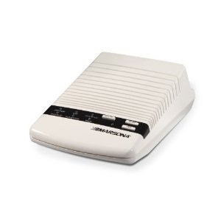
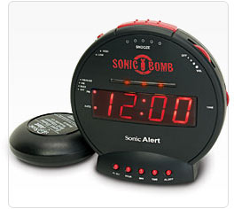
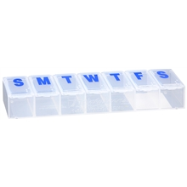
Other Tools
Sound Conditioner
Image taken from: www.marpac.com
Vibrating Alarm Clock with loud alarm
Image taken from www.sonicalert.com
Pill Box
Image taken from:
www.walgreens.com
Notes:
Address sleep issues, help waking up – application issues,

Slide 41
Our Process
Initial Interview/ Observation
Consult with appropriate therapists
Discuss tasks that need to be addressed
Discuss abilities and difficulties of the person
Discuss key environments as appropriate
Prioritize the list of tasks
Notes:
Adapted from the WATI

Slide 42
Solutions
Solution Generation – Brainstorming
  Include the consumer/patient
Identify specific solutions to be used
  1) immediately
  2) in the next few months
  3) in the future
Implementation Plan (Including trial periods)
Notes:
Adapted from the WATI

Slide 43

Follow Up
Review the trial periods and discuss feedback from the service member
Make any decisions about permanent use
Review the service member’s progress with the original task
Re-evaluate as needed
Notes:
Adapted from the WATI

Slide 44
If you only remember one thing…..

Slide 45

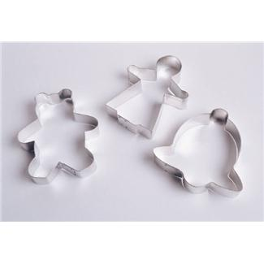
We aren’t making cookies!
Notes:
Avoid the “Cookie Cutter” solutions

Slide 46

Assistive Technology is
Creativity!
No two individuals are the same
  What works for one may not work for others
There is no “wrong way” to use tools
  If it works to accomplish the goal – great!
Avoid “tunnel vision”
  Keep an open mind!
Notes:
Examples: washcloth and hair tie – built up grip; tennis ball – sound muffler for chairs, pen grip, or card holder;
Phone book – card holder; potato masher – reacher or knob turner
Possibly bring some tennis balls for a tangible example.

Slide 47
Resources
Your team!
State AT Act Programs
  www.ataporg.org
Professional Organizations
  Ex. RESNA, ATIA
Notes:
The TEAM is INCLUDING the patient!!!

Slide 48
Other Resources
Department of Veteran’s Affairs
www.va.gov
Polytrauma System of Care www.polytrauma.va.gov
Notes:
As patients transfer, it helps to remember these resources.

Slide 49
References
Culley C, Evans JJ. (2010). SMS Text Messaging as a Means of Increasing Recall of Therapy Goals in Brain Injury Rehabilitation: A Single-Blind Within-Subjects Trail. Neuropsychological Rehabilitation, 20(1). 103-119.
Fish J, Manly T, Emslie H, Evans JJ, Wilson BA. (2008). Compensatory Strategies for Acquired Disorders of Memory and Planning: Differential Effects of a Paging System for Patients with Brain Injury of Traumatic Versus Cerebrovascular Aetiology. J Neurol Neurosurg Psychiatry. 79. 930-935.
Hoogerdijk B, Runge U, Haugboelle J. (2011). The Adaptation Process After Traumatic Brain Injury: An Individual and Ongoing Occupational Struggle to Gain a New Identity. Scandinavian Journal of Occupational Therapy. 18. 122-132.
Kraus JK, Schaffer K, Ayers K, Stenehjem J, Shen H, Afifi AA. (2005). Physical Complaints, Medical Service Use, and Social and Employment Changes Following Mild Traumatic Brain Injury: A 6 Month Longitudinal Study. J Head Trauma Rehabilitation. 20 (3). 239-256.
Lopresti EF, Milhailidis A, Kirsch N. (2004). Assistive Technology for Cognitive Rehabilitation: State of the Art. Neuropsychological Rehabilitation, 14(1/2), 5-39.
Lund ML, Lovgren-Engstrom AL, Lexell J. (2011) Using Everyday Technology to Compensate for Difficulties in Task Performance in Daily Life: Experiences in Persons with Acquired Brain Injury and Their Significant Others. Disability and Rehabilitation: Assistive Technology. 6(5). 402-411.
Scherer MJ. (2005). Assessing the Benefits of Using Assistive Technologies and Other Supports for Thinking, Remembering, and Learning. Disability and Rehabilitation. 27(13).731-739.

Slide 50
Questions?
Amanda Reinsfelder (WRNNMC-B)
  amanda.m.reinsfelder.civ@health.mil
  (202) 257-5756
Mark Lindholm (WRNNMC-B)
  mark.lindholm@med.navy.mil
  (973) 903-5774
Celene Moorer (NICOE)
  (301) 319-3634
  celene.moorer@med.navy.mil

